Slide 1
Vision Diagrams Series Insider Risk Management
Thierry Matusiak - Information Protection Architect
Version : 2023-03-27

Slide 2
Insider Risk Management
monitors internal users activity
to identify suspicious behaviors
Insider Risk Management – Definition
Notes:
Insider Risk Management monitors internal users activity to identify suspicious behaviors.

Slide 3
Insider Risk Management – Summary
Notes:
Insider Risk Management (IRM) consists in a set of monitoring policies. They analyze activity and generate alerts. Reviewers can confirm relevant alerts into IRM Cases. Serious problems can result in formal investigations run in the eDiscovery module.
IRM analyzes various sources of activity.

Slide 4
Insider Risk Management – More Details
Notes:
Data Connectors can feed IRM with additional information. Policies define who is monitored and what behaviors to monitor. Alerts can feed an external SIEM. Cases provide various tools : activity and content analysis, Teams collaboration, PowerAutomate actions,...

Slide 5
Insider Risk Management – Even More Details
Notes:
You can configure various global IRM settings. IRM offers a dedicated audit Log.
User Activity Reports allow to temporarily monitor users. Policy triggers initiate user's monitoring. Policy indicators accumulate and may result into raising an alert.
IRM offers a modular and flexible permission model.

Slide 6
Vision Diagrams Series Insider Risk Management
Thierry Matusiak - Information Protection Architect

Slide 7

Conclusion

Slide 8


Slide 9
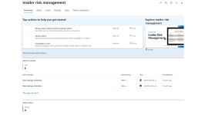
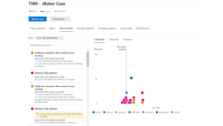
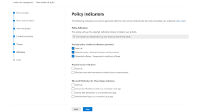
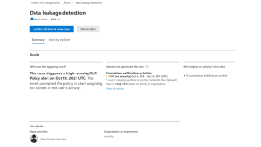
Insider Risk Management – Summary

Slide 10
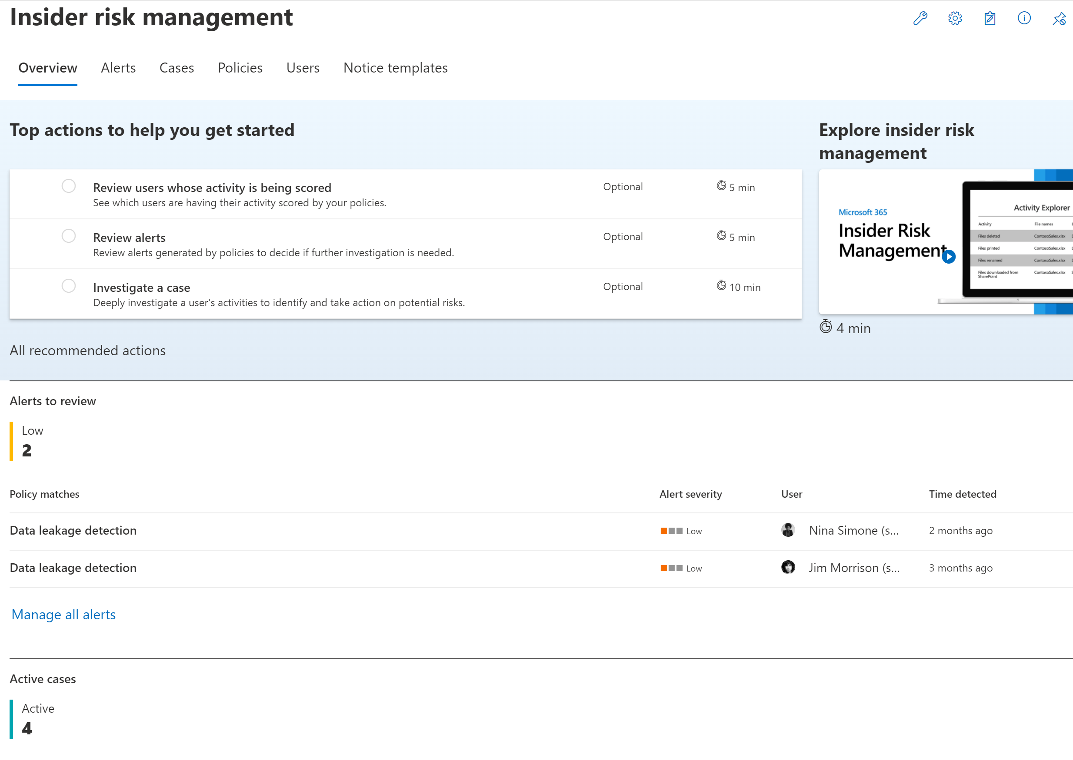

Slide 11
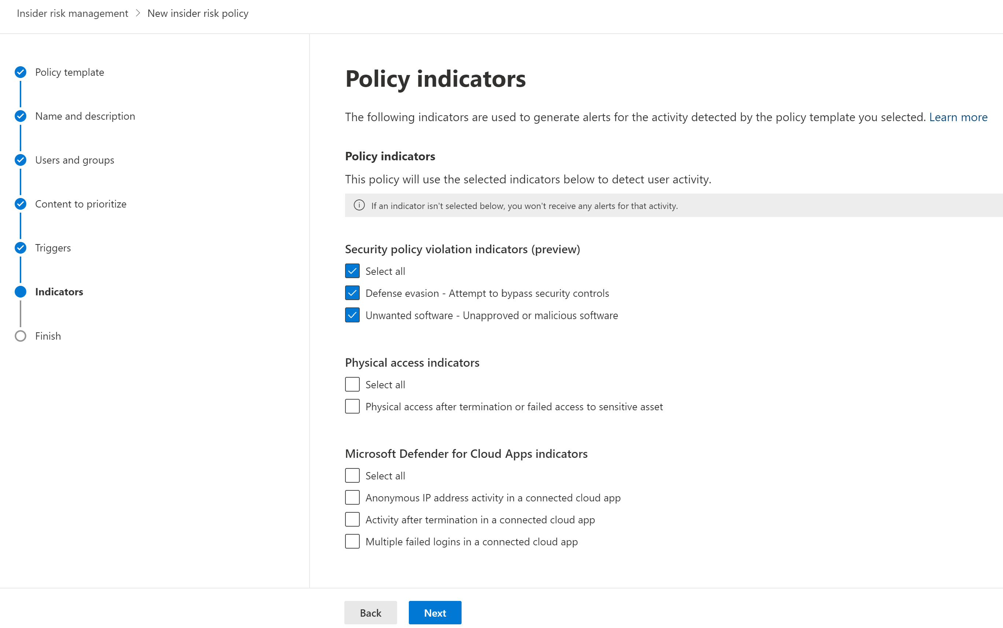

Slide 12
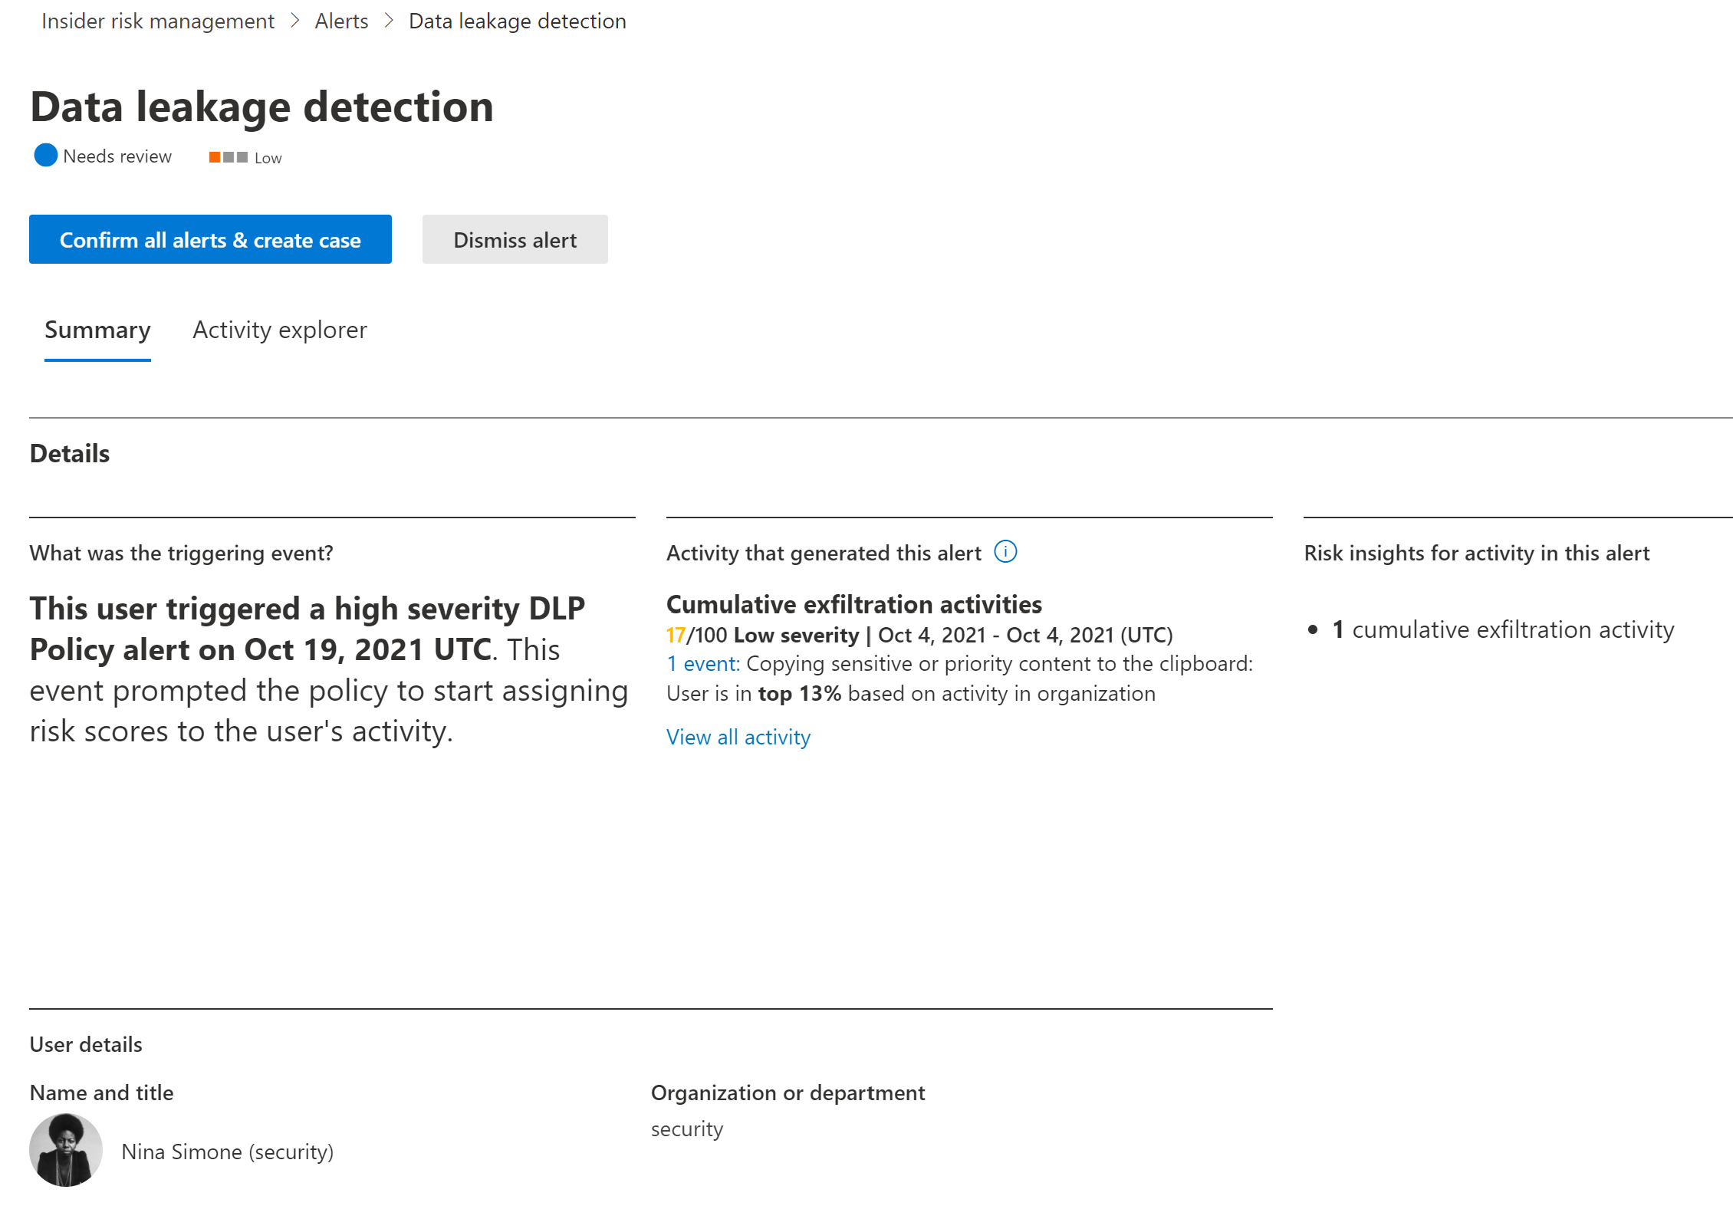

Slide 13
